Slide 1

Automatic Automotive Hacking

Slide 2

@OpenGarages

Slide 3
Problem Statement
Hard to analyze complex CAN Traffic
Dealership Tools Trust the Vehicle
Older Tools required manual code changes

Slide 4
Uds-server PoC
Simulates UDS responses
Usage: ./uds-server [options] <can_interface>
-z Increase fuzz level
-v Verbose
-l <logfile> Log output to file instead of STDOUT
-c Don't fuzz ISOTP Spec, just data
-F Disable flow control (Functional Addressing)
-V <vin> Specify VIN (Default: WAUZZZ8V9FA149850)

Slide 5
Howto Automate Hacking
Remove coding requirements
Implement a Self Learning System
Provide a GUI :-)

Slide 6

CAN Packets

Slide 7
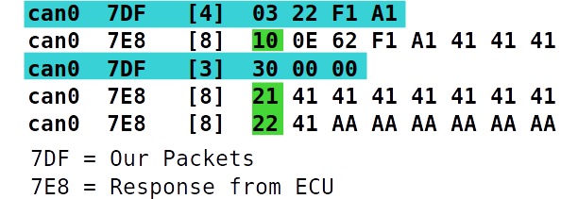
ISO-TP

Slide 8
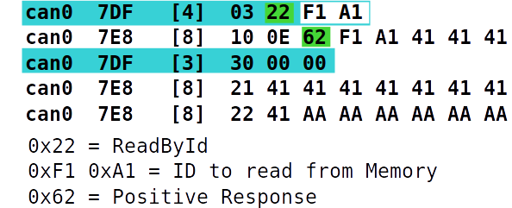
UDS

Slide 9
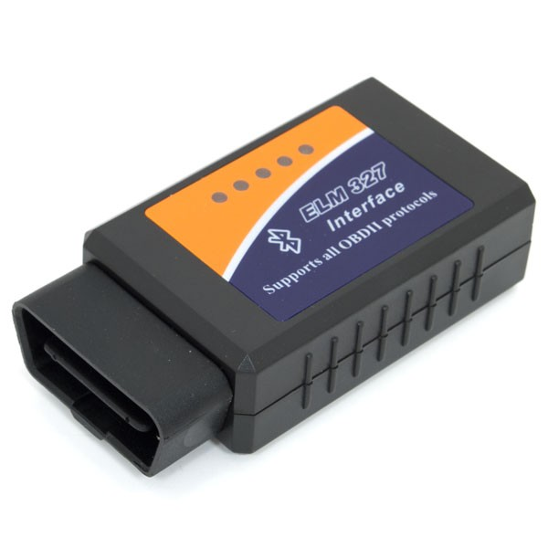
OBD Dongles

Slide 10
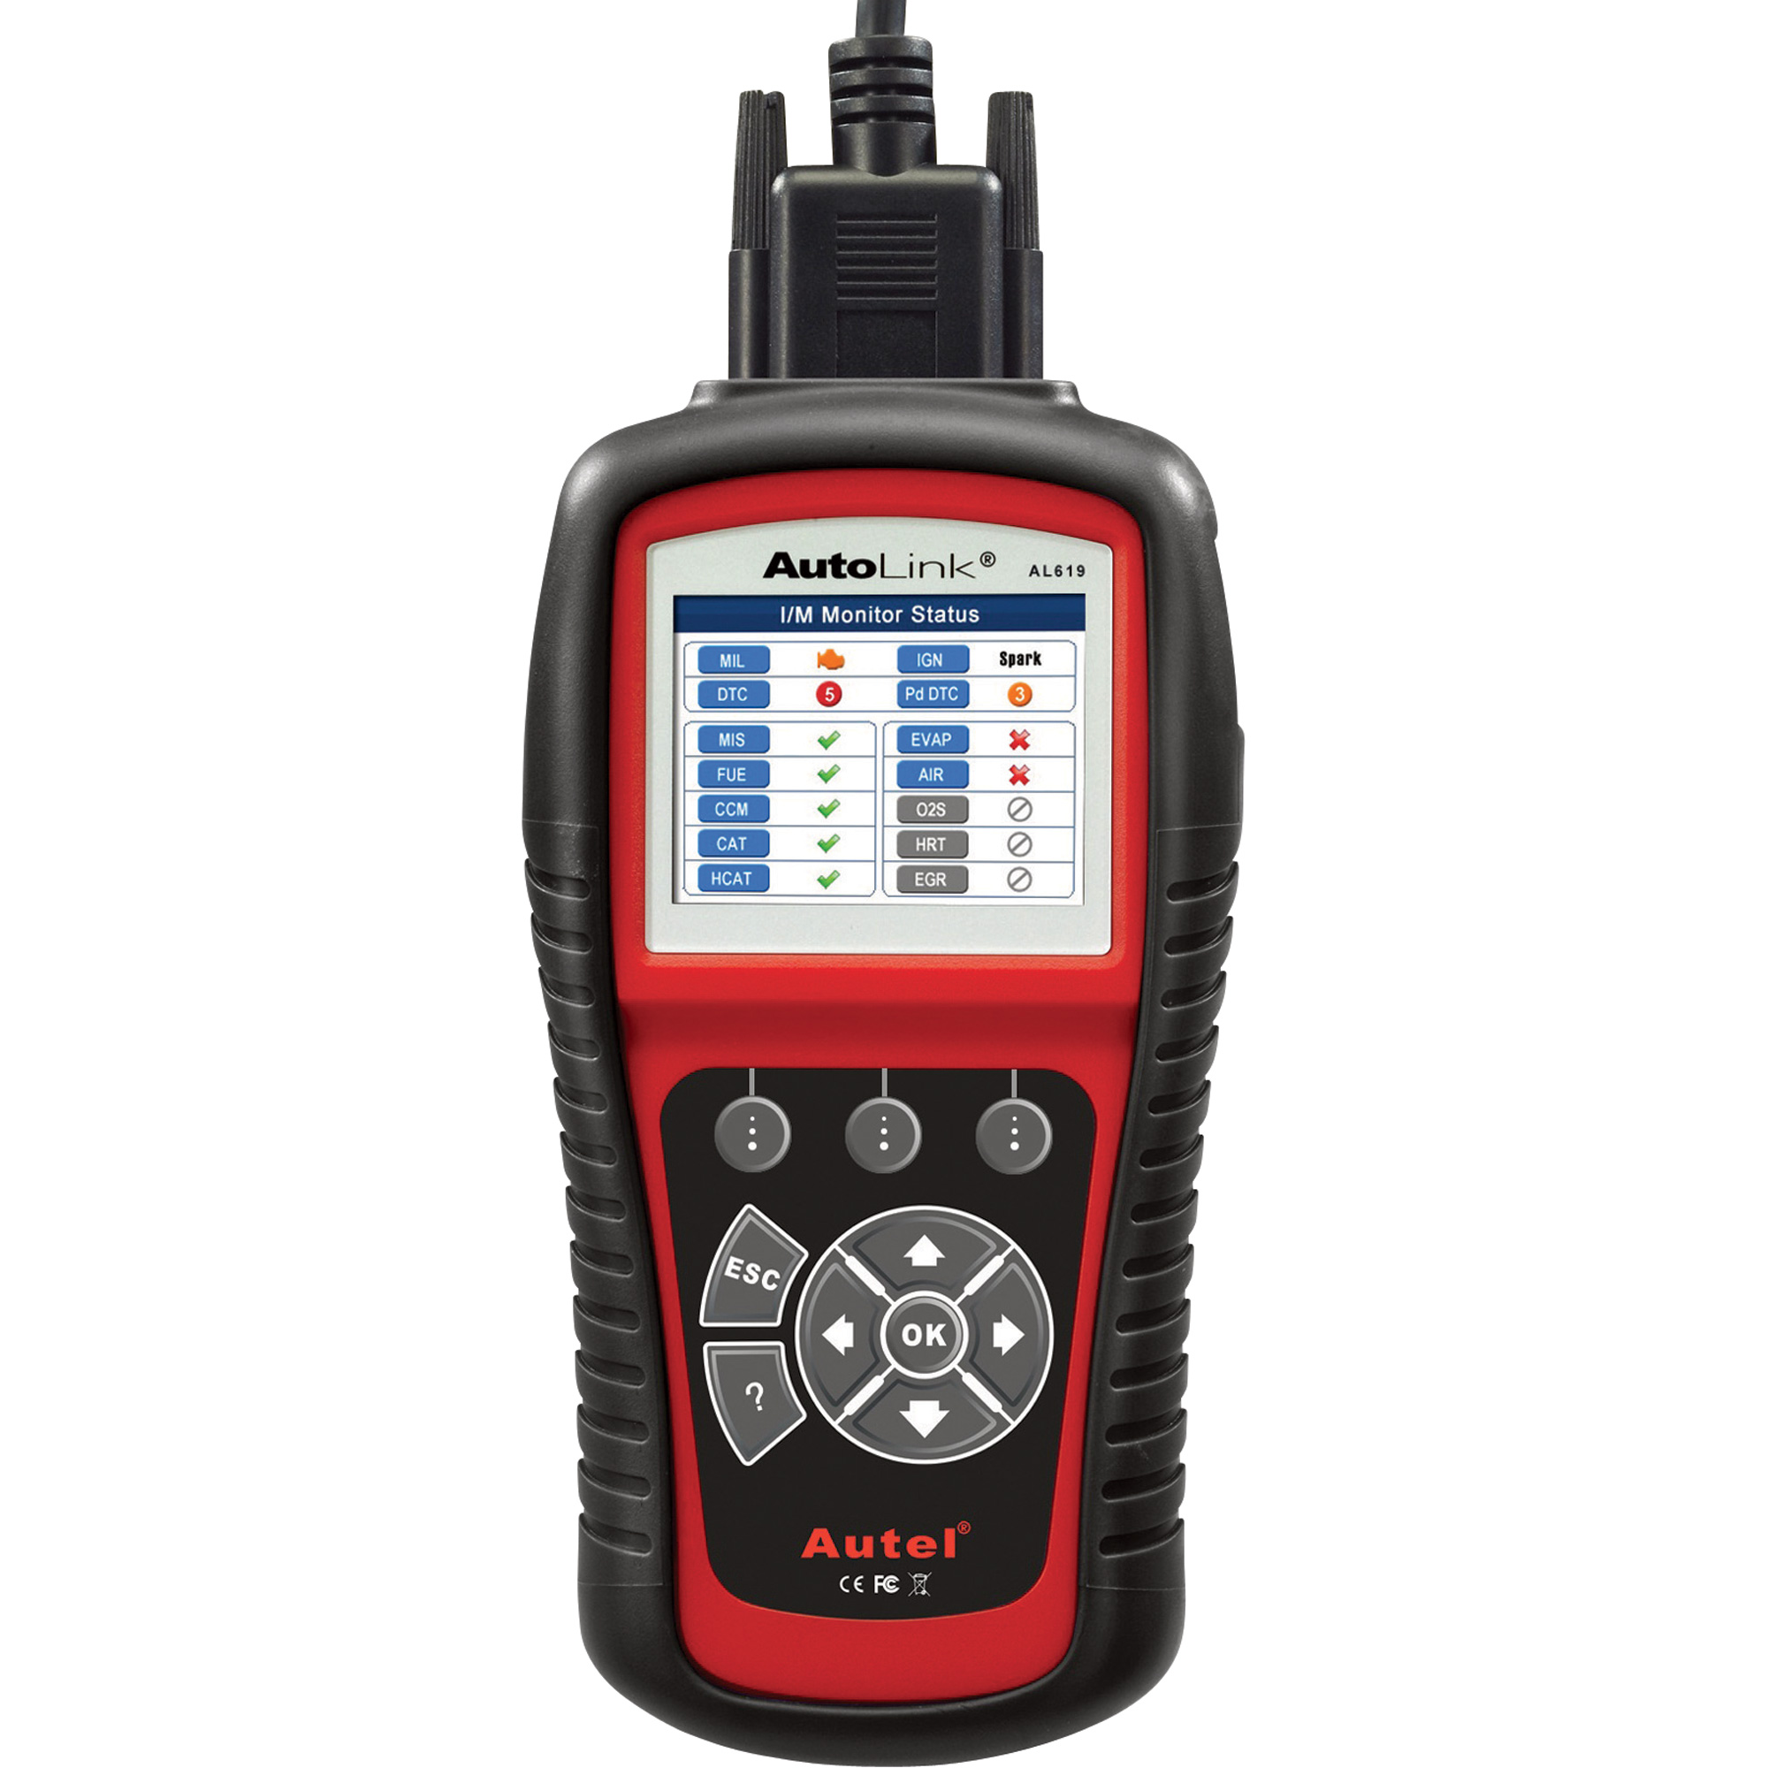
Automotive Tools

Slide 11
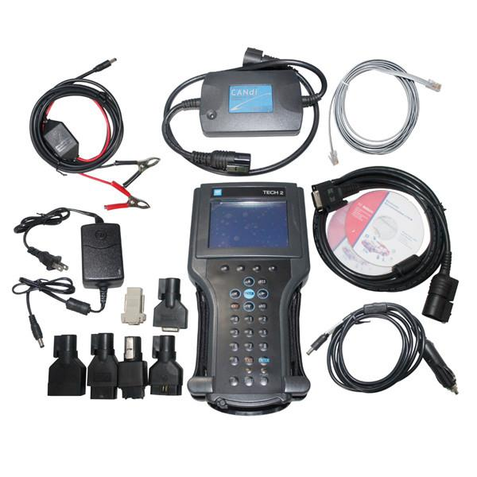
Dealership Tools

Slide 12

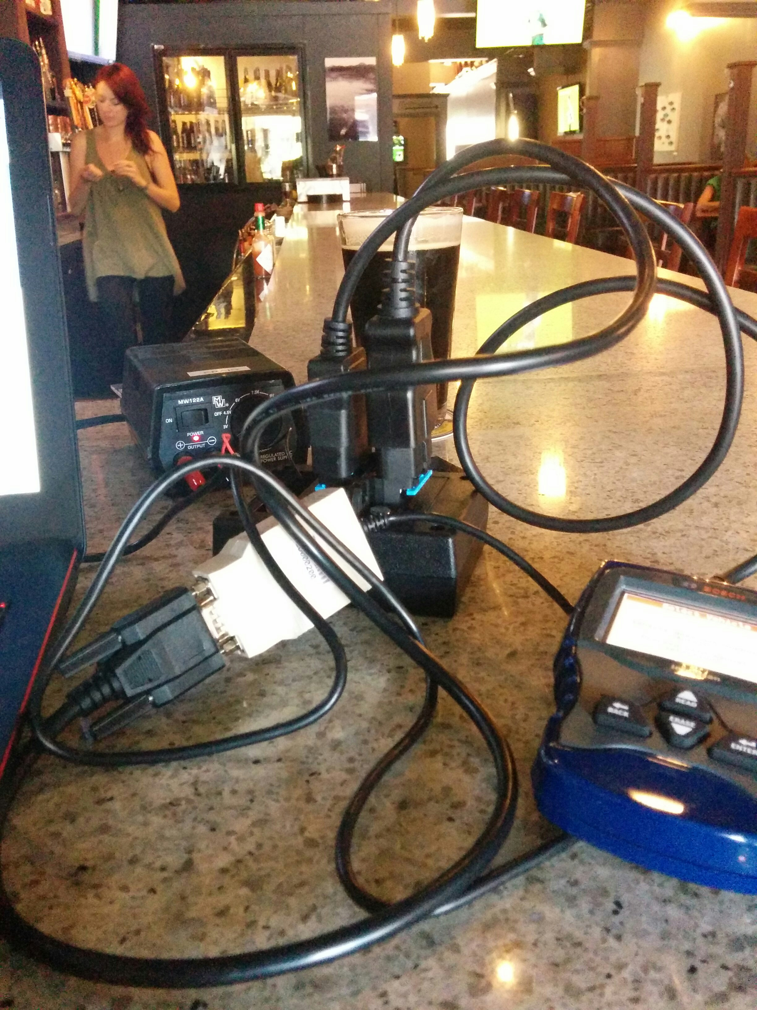
Sniffing Setup
Recording UDS
Emulating a Vehicle

Slide 13
Demo
Can traffic
Cansniffer
UDSim reading network
UDSim Emulating Vehicle System
Fuzzing?

Slide 14


Slide 15
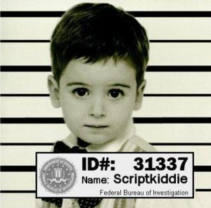
Car Hacking is getting easier
Up and running hacking/fuzzing in minutes

Slide 16
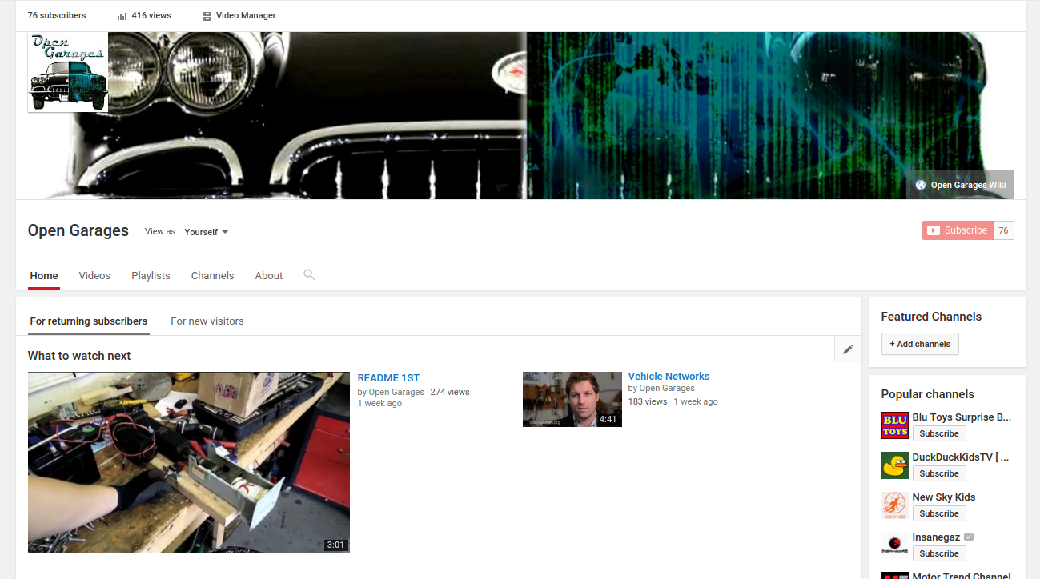
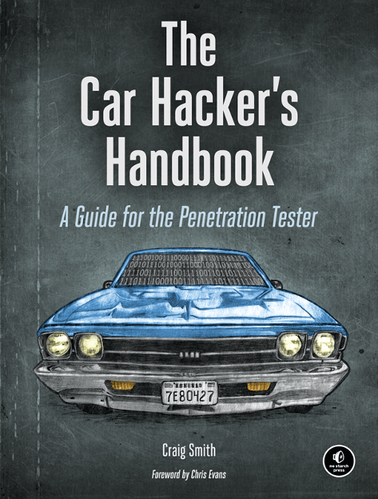
Resources

Slide 17
UDSim
https://github.com/zombieCraig/UDSim
Required Libraries:
Libsdl2-dev
Libsdl2-image
Libsdl2-ttf

Slide 18
Contact / Q&A
Craig Smith
Craig@TheiaLabs.com
OpenGarages.org (@OpenGarages)
IamTheCavalry.org (@IAmTheCavalry)

